Slide 1
,
Regular Expressions

Slide 2
Topics
What is a regular expression
Regular expression components
Construct regular expressions

Slide 3
Define Regular Expressions
A pattern of special characters used to match strings in a search
Typically made up from special characters called metacharacters
Regular expressions are used throughout Unix/Linux
Editors: vim, ex, ed
Utilities: grep, egrep, sed, and awk

Slide 4
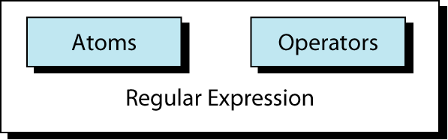
Regular Expression Forms
An atom specifies what text is to be matched and where it is to be found
An operator combines regular expression atoms

Slide 5
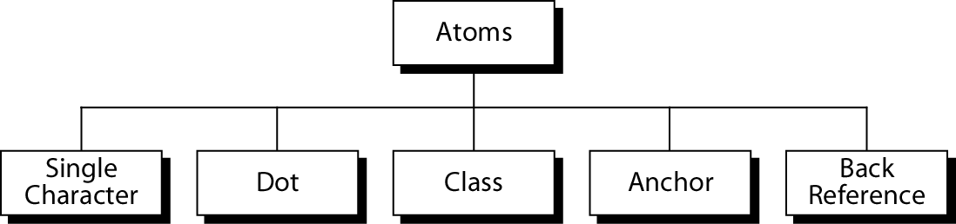
Atoms
An atom can be one of 5 types

Slide 6
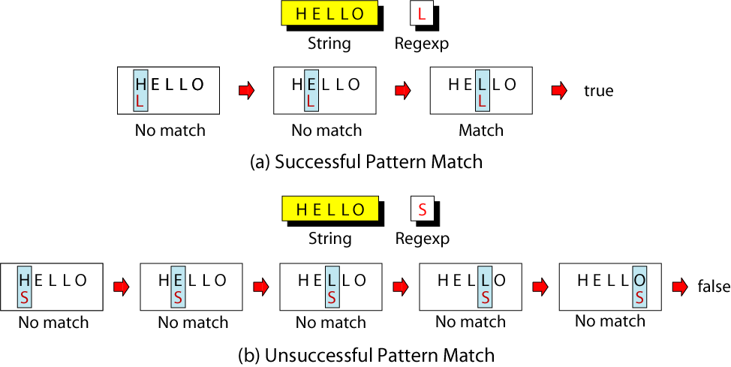
Single Character Atom
A single character matches itself
Notes:
Open: http://www.regexpal.com
The top box is for entering regular expressions, and the bottom one holds the subject or target text. The target text is the text or set of strings that you want to match.
Enter this in the top box: ^(\(\d{3}\)|^\d{3}[.-]?)?\d{3}[.-]?\d{4}$
Now enter this in the bottom box: 704-333-4590
What you should see is the phone number you entered in the lower box highlighted from beginning to end in yellow. If that is what you see, then you are in business.

Slide 7
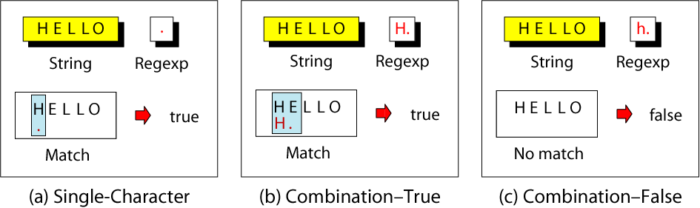
Dot Atom
Matches any single character except the new line character

Slide 8
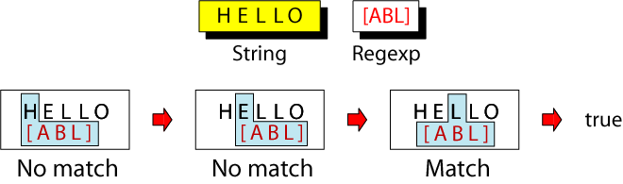
Class Atom
Matches any one of the characters in a set
1) A range of characters is indicated by a dash, e.g. [A-Q]
2) Can specify characters to be excluded from the set, e.g. [^0-9] matches any character other than a number.
Notes:
The dot matches any single character. This is often too general. The class Atom defines a set of ASCII 1 characters, any one of which may match any of the characters in the text. The character set to be used in the matching process is enclosed in brackets.
The class set is a very powerful expression component. Its power is extended with three additional tokens: ranges, exclusion, and escape characters. A range of text characters is indicated by a dash (-). Thus, the expression [a-d] indicates that the characters a and b and c and d are all included in the set.
3. Sometimes it is easier to specify which characters are to be excluded from the set -- that is, to specify its complement. This can be done using exclusion, which is the UNIX not operator (^). For example, to specify any character other than a vowel, we would use [^aeiou]. The not operator can also be used with ranges. To specify any character other than a digit, we would use [^0-9].

Slide 9
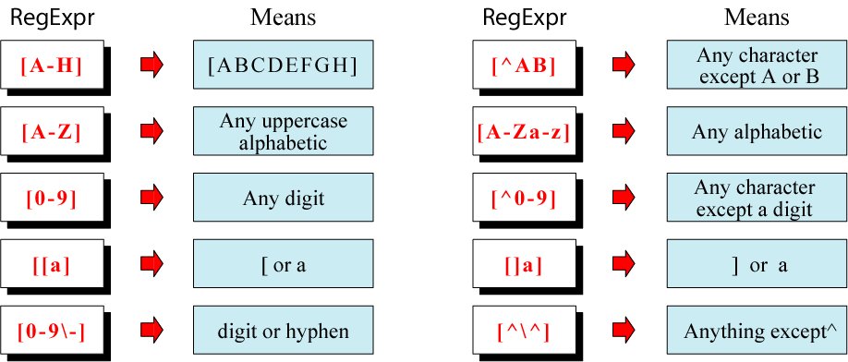
Class Examples
Notes:
A ^ inside a class atom bracket set is a complement; it is interpreted as any ASCII character except those identified in the set.
The third additional token is the escape character (\). It is used when the matching character is one of the other two tokens. For example, to match a vowel or a dash, we would use the escape character to indicate that the dash is a character and not a range token. This example is coded [aeiou\-]

Slide 10
Short-hand Classes
\w word
\W non-word
\s space
\S non-space
\d digit
\D non-digit

Slide 11
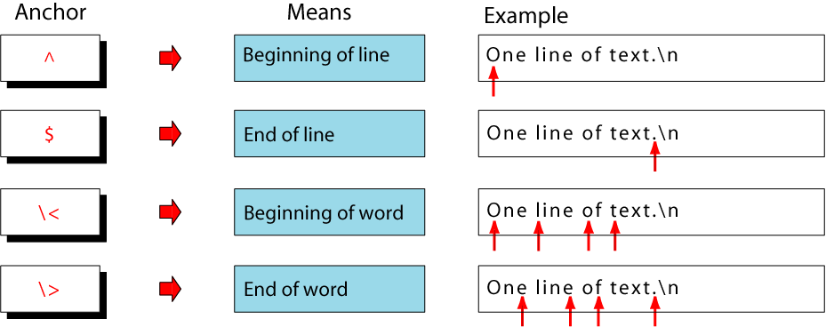
Anchors
Tell where the next character in the pattern must be located in the text data
Notes:
Anchors are atoms that are used to line up the pattern with a particular part of a string. In other words, anchors are not matched to the text, but define where the next character in the pattern must be located in the text. There are four types of anchors: beginning of line (^), end of line ($), beginning of word (\<), and end of word(\>).
A ^ character at the beginning of a regular expression is an anchor and means beginning of the current line. Anywhere else, it matches itself as a text character. A $ character at the end of a regular expression is an anchor and means end of the current line. Anywhere else, it matches itself as a text character.

Slide 12
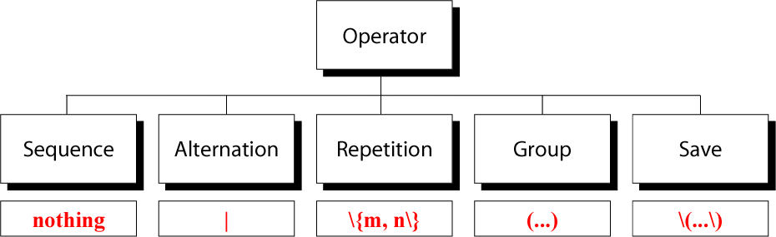
Operators
Link atoms
Notes:
The regular expression operators play the same role as mathematical operators. Mathematical expression operators combine mathematical atoms (data); regular expression operators combine regular expression atoms.
We can group the regular expressions into five different categories: sequence operators, alternation operators, repetition operators, group operators, and save operators.

Slide 13
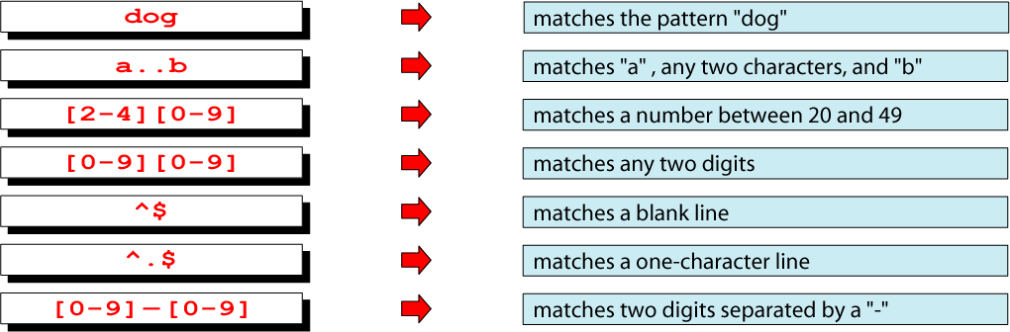
Sequence Operators
Sequence operators are invisible
Match all the characters from left to right sequentially
Notes:
We can group the regular expressions into five different categories: sequence operators, alternation operators, repetition operators, group operators, and save operators.

Slide 14
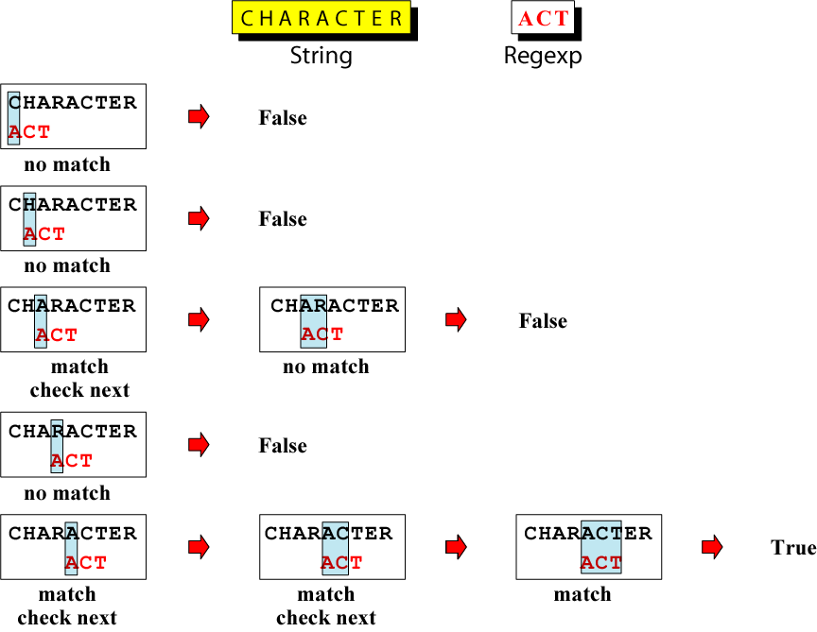
Sequence Operators at Work
Notes:
The comparison begins by checking the first letter of the string, C, with the first letter of the expression, A. They are not equal, so there is no match. But the string has not been fully evaluated, so the evaluation continues by comparing the H in CHARACTER with the first letter of the expression, A. Again, there is no match. When the third character is matched against the pattern, the result appears to be true—the A in CHARACTER matches the A in ACT. Because the expression has three characters, however, the match is not complete. All three characters in the patterns must match a sequence in the string. Matching the next character in the string (R) with the second character in the expression (C) results in a nonmatch.
Again, when the matching reaches the fifth character in the string, a match is found; A appears in both the string and the pattern. This time, the next two characters also match the expression values, so there is a complete match and true is returned.

Slide 15

Alternation Operator
The alternation operator (|) is used to define one or more alternatives
Notes:
The alternation operator (|) is used to define one or more alternatives. For example, if we want to select between A or B, we would code the regular expression as A | B. Alternation can be used with single atoms, as in the previous example, but it is usually used for selecting between two or more sequences of characters or groups of characters. That is, the atoms are usually sequences. For single alternation, we suggest that you use the class operator.
In the first example in the figure, we are looking for either UNIX or unix. This example locates UNIX whether it is lowercase or uppercase. In the second example, we are looking for any of the female designations, Miss, Ms, or Mrs. In the first example in the figure, we are looking for either UNIX or unix. This example locates UNIX whether it is lowercase or uppercase. In the second example, we are looking for any of the female designations, Miss, Ms, or Mrs.
Regex engines
DFA (Deterministic Finite Automation) – faster. Each character is matched at most once. Alternation metasequence is greedy. When more than one alternation (foo|foobar) matches, the longest one is selected.
NFA (Non-deterministic Finite Automation)
Traditional NFA – compares each element of the regex to the input string, keeping track of positions where it chose between two options in the regex.
Xxxx

Slide 16
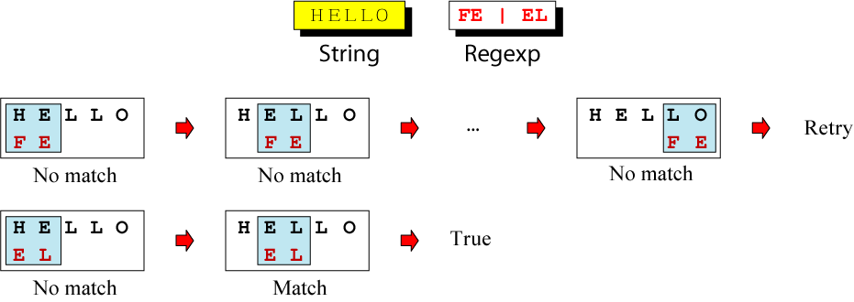
Matching Alternation Operator
Notes:
Above diagram shows how text is matched. It is a descriptive example and may not be the way the UNIX programmer implemented it. The match begins by matching the expression pattern to the text. When the H doesn’t match, it moves to the next character, E. Again, no match. The matching continues until the string is exhausted. At that point, UNIX repeats the matching with the second alternative, EL. This time, it finds a match in the second and third characters and returns true.

Slide 17
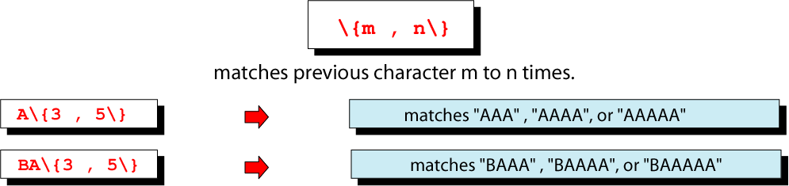
Repetition Operators
Specify how many times the immediate proceeding character may be repeated
Notes:
The repetition operator is a set of escaped braces (\{…\}) that contains two numbers separated by a comma
It specifies that the atom or expression immediately before the repetition may be repeated. The first number (m) indicates the minimum required times the previous atom must appear in the text; the second number (n) indicates the maximum number of times it may appear. For example, repetition operator \{2, 5\} indicates that the previous atom may be repeated two to five times. One is not enough, and six are too many; both result in no match.

Slide 18
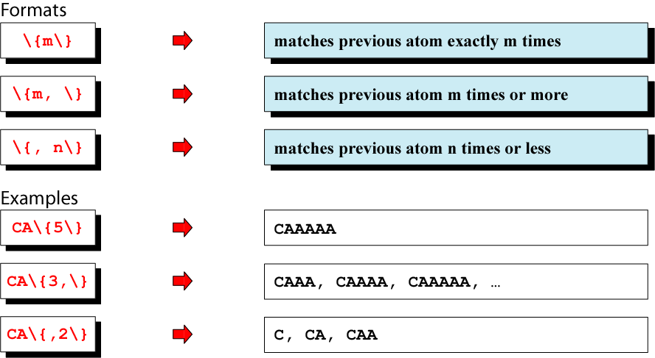
Basic Repetition Forms
Notes:
The m and n values are optional, although at least one must be present. That is, either may appear without the other. If only one repetition value (m) is enclosed in the braces, the previous atom must be repeated exactly m times—no more, no less. This code follows. In this example, the previous atom must be repeated exactly three times.

Slide 19
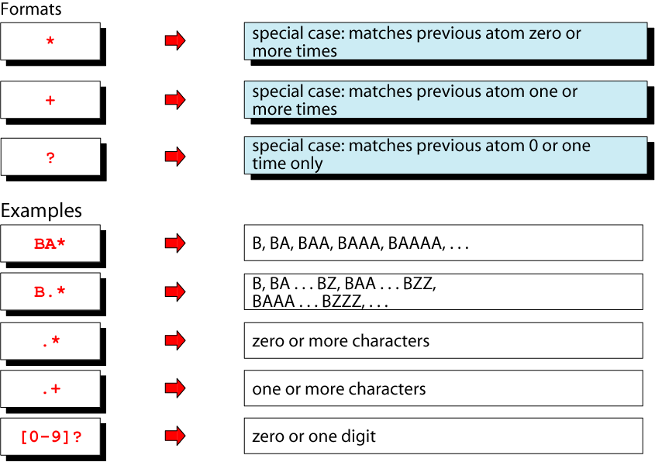
Short Form Repetition Operators
Notes:
Three forms of repetition are so common that UNIX has special shortcut operators for them.
The asterisk (*) may be used to repeat an atom zero or more times. (It is the same as \{0,\}.)
The plus (+) is used to specify that the atom must appear one or more times. (It is the same as \{1,\}.)
The question mark (?) is used to repeat the pattern zero or one time only. (It is the same as \{0,1\}.)
The asterisk operator (*) has a meaning in a regular expression that is different from its meaning as a wildcard. In a regular expression, it means repeat the previous character or group of characters zero or more times. As a wildcard in a filename, it means zero or more characters. The regular expression usage means that it cannot be used by itself; it must be preceded by an atom or a group of atoms.
The question mark operator (?) also has a meaning in a regular expression that is different from its meaning as a wildcard. In a regular expression, it means repeat the previous character or group of characters zero or one time. As a wildcard in a filename, it means one character. The regular expression usage means that it cannot be used by itself; it must be preceded by an atom or a group of atoms.

Slide 20
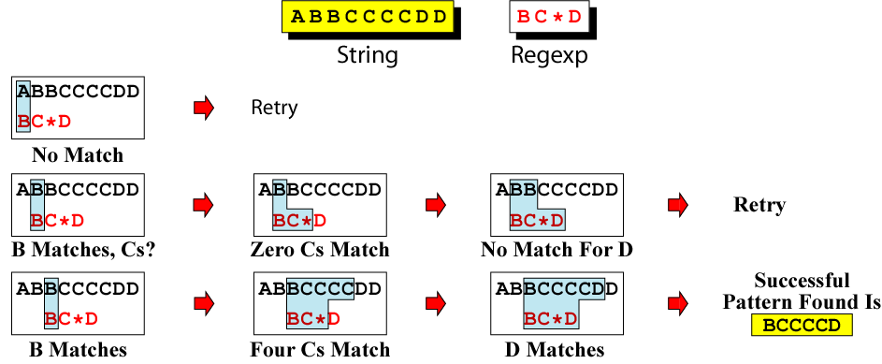
Repeating Pattern Matching
Notes:
Above diagram illustrates how a regular expression using a repeating operator matches text in a line. It begins by searching the string for a matching B, which it finds in the second position. It then looks for zero or more Cs. When it finds the first non-C in position 8, it looks for and finds a matching D, which completes the required pattern. The regular expression is therefore true.

Slide 21
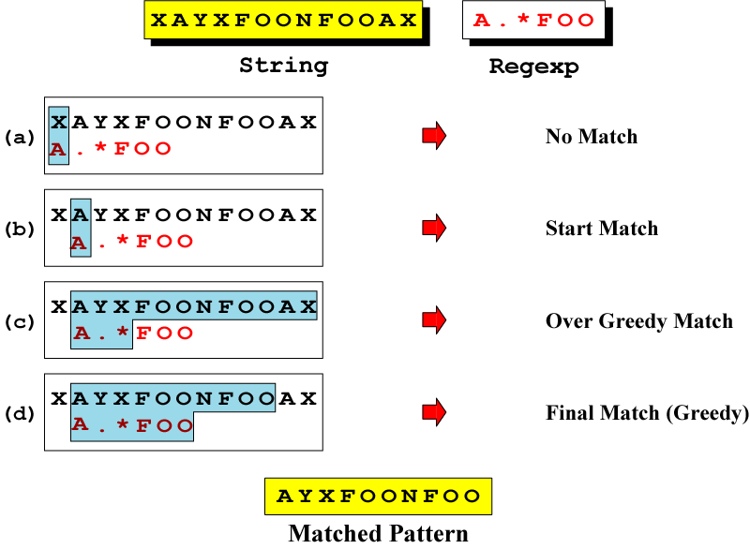
Greedy Matching
Notes:
Repeating operators in UNIX are part of a general class of algorithm known as greedy algorithms. Greedy algorithms are designed to maximize their operation. In pattern matching, greedy means that the longest possible string of characters that matches a pattern should be used.
When a regular expression involving repeating operators is used, the repeating part tries to consume as much matching text as it can. To understand the concept, examine the above example. In this example, the expression requires a string that starts with an A and ends with FOO, with zero or more characters between them. Note that there are two FOO character patterns in the string.
The pattern match begins by locating the A in the second position. It then greedily consumes the rest of the string to the newline. This is the position in (c). Having found the maximum string, it then backs up until it finds a matching FOO in Figure (d). Note that this approach finds the longest possible matching pattern, which is the one ending with the second FOO.

Slide 22
Stop Being Greedy
The easiest solution to the greedy behavior of regular expression is to add a question mark
Notes:
Problem with the greedy regex. For example, <b>(.*)</b> On the surface of it, it looks as though the parentheses are a capturing group that will allow us to see the content between the two bold tags. But this is not what happens. Consider this: blah <b>one</b> blah blah <b>two</b>YO! After the opening bold tag has been matched, the dot star will roll all the way down to the end of the string, then gradually backtrack to allow the closing bold tag to match. Once it has backtracked to the second closing bold tag, the regex is able to match. Therefore, Group 1 ends up capturing the text in bold: blah <b>one</b> blah blah <b>two</b>YO!
The easiest all-weather solution to this kind of problem is to add a question mark after our star quantifier. This gives us <b>(.*?)</b>. In this expression, the quantifier (the star and question mark) is said to be "lazy". What does "lazy" mean? It mean that the expression being quantified will only match as few characters as possible to allow the overall match to succeed. For instance, if it could, our .*? would match zero characters (since star means zero or more). But in our string, the regex does not stop at .*?: it still needs to match </b>. So the quantifier expands the match until the regex can continue and match </b>. The (.*?) therefore perfectly captures the gap between the <b> and the </b>, which is just what we need. On our string, if the regex engine is allowed to find multiple matches, it will match the two strings in bold: blah <b>one</b> blah blah <b>two</b>YO!
See: http://www.rexegg.com/regex-greed.html

Slide 23
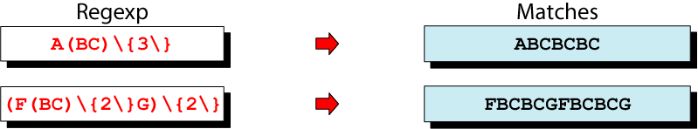
Group Operators
In the group operator, when a group of characters is enclosed in parentheses, the next operator applies to the whole group, not only the previous characters
Notes:
The group operator is a pair of opening and closing parentheses. When a group of characters is enclosed in parentheses, the next operator applies to the whole group, not only to the previous character. In the first example, the group (BC) must be repeated exactly three times.
The second example is more complex because there are two repeating groups. The first group, BC, must be repeated twice. This inner group is combined with a leading F and a trailing G to form the second group, FBCBCG, which is then repeated twice. Study the figure carefully to make sure you understand how the group
operator works.

Slide 24
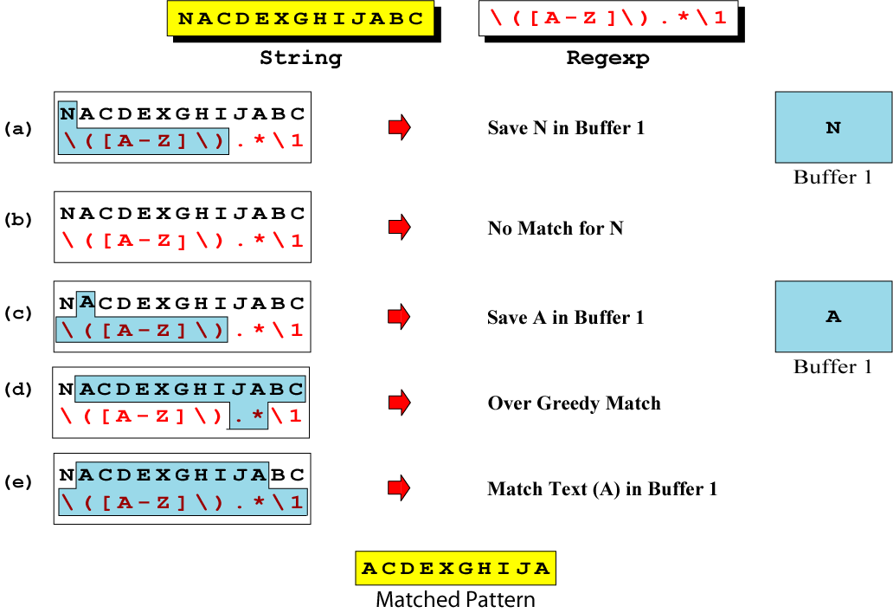
Save Operator
Notes:
The save operator, which is a set of escaped parentheses, \(…\), copies a matched text string to one of nine buffers for later reference. Within an expression, the first saved text is copied to buffer 1, the second saved text is copied to buffer 2, and so forth for up to nine buffers. Once text has been saved, it can be referred to by using a
back reference.
As a typical example of the save command, let’s create a pattern that matches text beginning and ending with the same letter. The problem is that we don’t know what the letters will be. The solution is to save the first letter of a text string in a buffer and then use the buffer to match with the last character in the string.

Slide 25
Saving and Grouping Metacharacters
Metacharacter | Meaning
\(...\) | Group subpattern and save as \1, \2, …, \9
\n | Use saved n^{th} subpattern
& | The whole matched pattern
~ | The previous substitute string

Slide 26
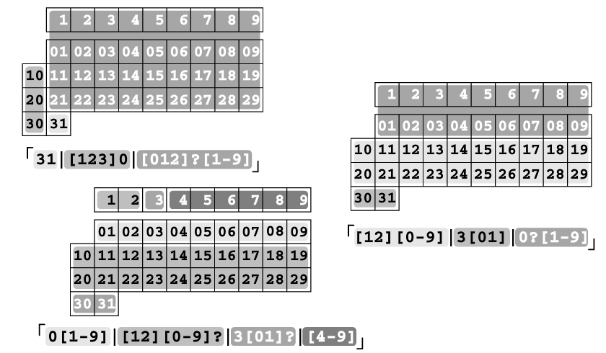
A Few Ways to Slice and Dice a Date
Notes:
Ordered alternation pitfalls – Match Jan 31
We need something more sophisticated than: Jan [0123][0-9], as it allows Jan 00, Jan 39, but disallows Jan 7
One way to match the date part is to attack it in sections.
Match from the first through the ninth – 0?[1-9] (allow a leading zero)
Adding [12][0-9] allows for 10~29
3[01] matches 30 and 31
Putting it all together, we get: Jan (0?[1-9]|[12][0-9]|3[01]). However, when matching “Jan 31 is Dad’s birthday”, the ordered alternation only matches Jan 3. Because the leading 0? fails, but the alternative matches ([0-9] has no trouble matching the 3).
When the order of the alternatives is adjusted so that the shortest amount of text is placed first, the problem goes away. This works: Jan (12[0-9]|3[01]|0?[0-9])
Another approach is: Jan (31|[123]0|[012]?[1-9]) – this requires careful arrangement of alternatives to avoid the problem.
A third approach is: Jan (0[1-9]|[12][0-9]?|3[01]?|[4-9]) – this works properly regardless of the order
A fourth approach is:

Slide 27
Lookahead & Lookbehind
Lookahead and lookbehind, collectively called lookaround, match characters before and after, then give up, returning only true or false.
Positive lookahead: (?=regex)
Negative lookahead: (?!regex)
Positive lookbehind: (?<=regex)
Negative lookbehind: (?<!regex)
Notes:
Matches all variants of Steve, Steven, and Stephen:
Ste(?=ve|ven|phen)
vim: :/\vSte(phen|ve|ven)\@=/

Slide 28
Online Bash Reference
See
http://www.gnu.org/software/bash/manual/bashref.html

Slide 29
Regex Engines
DFA (Deterministic Finite Automation)
The longest leftmost matches
NFA (Non-deterministic Finite Automation)
Traditional NFA
POSIX NFA
Hybrid DFA/NFA
Notes:
DFA –
for each character in the searched text, DFA look at it at most once. Issues of which match is longest aren’t conﬁned to alternation. Consider how an NFA matches the (horribly contrived) !one(self)?(selfsufficient)?" against the string oneselfsufficient. An NFA ﬁrst matches !one" and then the greedy !(self)?", leaving !(selfsufficient)?" left to try against sufficient. It doesn’t match, but that’s OK since it is optional. So, the Traditional NFA retur ns oneselfsufficient and discards the untried states.
Return the longest leftmost match (not just the alternation)
No look-around, capturing, and back-reference
NFA -
Most tools implement traditional NFA. GNU awk, egrep, and Tcl use a hybrid NFA/DFA.
Depending on the implementation and the base engine type, the following element may differ:
Syntax
What will be matched
Look-around features
Capture feature
Efficiency optimization

Slide 30
Summary
Shell provides a character-based user interface for the Unix kernel
A shell is both a command interpreter and a programming language
The shell also supports the following features:
Variable substitution
Filename generation
Pipes
Input/output redirection
User environment customization

